Slide 1
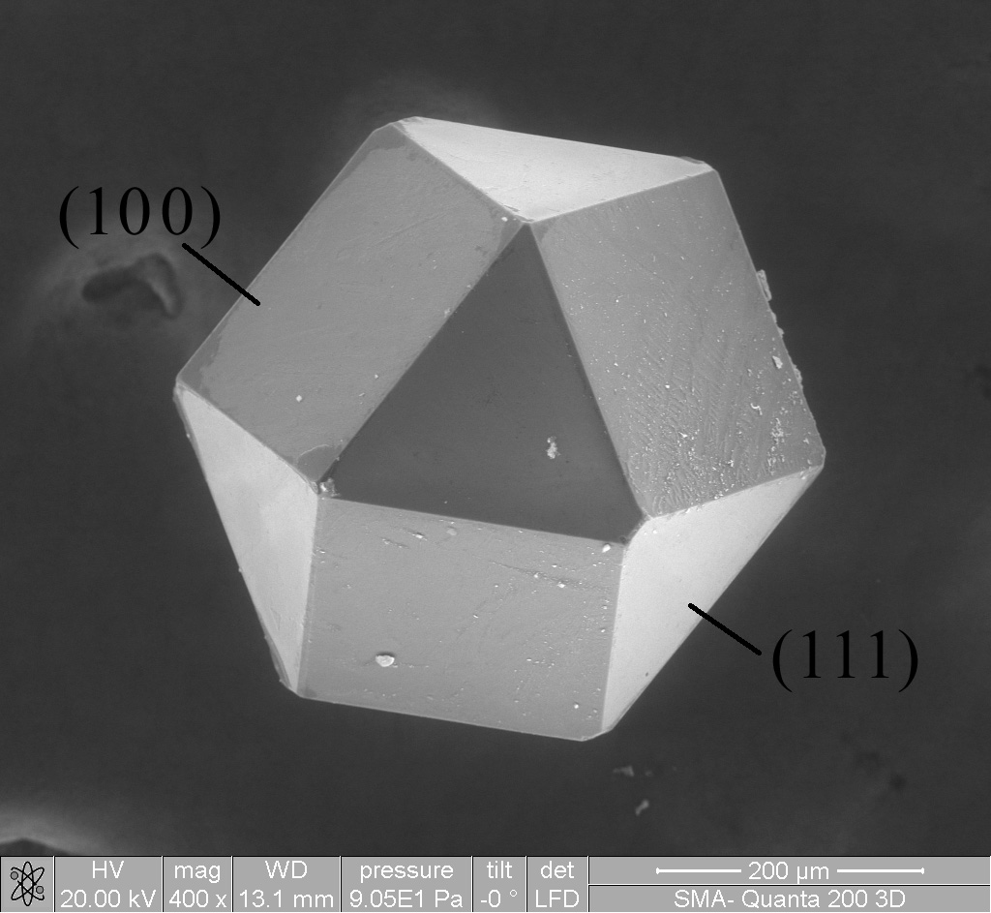
Materials Track
Why ChE MS?
Provides solid background in processing of materials
OPTIMIZATION!

Slide 2
Materials Track Courses
Either ChE 128 or ChE90ab
One of the following: Ch/ChE 147, ChE115, or MS133
One of the following: Ch120, ChE/Ch148, MS115, MS/APh120, MS/APh122, or MS131
Five materials science elective courses
Chosen from ChE118, ChE120, ChE/Ch155, ChE/Ch164, ChE/Ch165, or any MS courses

Slide 3
Sophomore Year
Ch 41a | 9 | Ch 41b | 9 | Ch 41c | 9
ChE 62 | 9 | ChE 63a | 9 | ChE 63b | 9
ACM 95a | 12 | ACM 95b | 12 | ACM 95c | 12
Ma 2a | 9 | Ma 2b | 9 | Ch/ChE 9 | 9
Ph 2a | 9 | Ph 2b | 9 | HSS | 9
Totals | 48 |  | 48 |  | 48
Junior Year
ChE 103a | 9 | ChE 103b | 9 | ChE 103c | 9
Ch 21a | 9 | ChE 101 | 9 | ChE 105 | 9
MS115 | 9 | Ch21b | 9 | ChE 115 | 9
CS 1 | 9 | MS/ME 162 | 9 | HSS | 9
HSS | 9 | HSS | 9 | HSS | 9
Totals | 45 |  | 45 |  | 45
Senior Year
ChE 126 | 9 | ChE 90a | 9 | ChE 90b | 9
MS/APh 120 | 9 | Ch/ChE 91 | 3 | MS/EST 143 | 9
MS/APh 122 | 9 | ChE/Ch 164 | 9 | HSS | 9
HSS | 9 | HSS | 9
 |  | HSS | 9
Totals | 36 |  | 39 |  | 27

Slide 4
Future Opportunities
Materials track is very diverse!
Grad school
Chemical Engineering
Materials Science Engineering
Industry
Electronics, Semiconductors
Polymers, Plastics
Product and Material Design
Alternative Energy, Oil

Slide 5
Materials Track Advice
Plan ahead!
Keep your course options open
If it’s offered, TAKE IT
MS courses are not always offered, even if mentioned in catalog
Courses may say “offered every other year”, but that’s a lie 90% of the time

